Slide 1


Product Owner

Slide 2
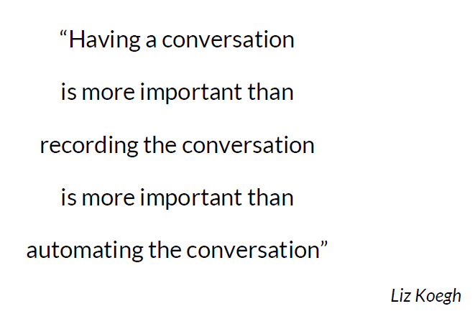

Slide 3
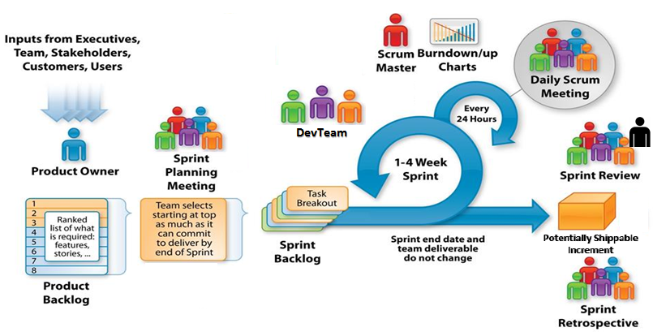
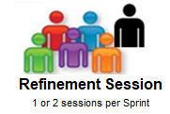
For Future Sprints
Adapted from: http://csharpcorner.mindcrackerinc.netdna-cdn.com/UploadFile/BlogImages/11292015063901AM/SystemsPlus-Scrum-Image-.jpg

Slide 4

Product Owner
Owns Product Vision
Define the features of the product
Decide on release date and content
Responsible for the delivery of Business Value
Offer stories to DevTeam in Sprint Planning
Accept or reject increment
Ref: https://github.com/tusjain/agileanswer/blob/master/repository/I%20as%20a%20Product%20Owner.pdf
4
Notes:
Speaker Notes

Slide 5
Product Owner vs Product Manager
Product Owner
Leads requirements gathering effort — talking with product management, implementation teams, clients, and other stakeholders
Documents story details based on the epics/features in consultation with implementation teams
Attends Scrum meetings
Leads Product Backlog refinement effort
Interact with implementation team to facilitate development efforts
Documents the new feature for implementations and release notes.
Product Manager
Tracks the overall market and competitive dynamics
Manages the long-term roadmap, involving sales, marketing, implementations, clients, prospects, partners, and other groups
May attend iteration demos
Supports non-technical teams (such as sales, marketing, and channel).
Responsible for Life cycle of the product
May own budget
Product Owner + Product Manager
Write Acceptance Criteria
Demonstrate the product to customers (pre-release as well) and gathers feedback
5
Notes:
Speaker Notes

Slide 6
Product Owner
Stand Up
Attend Stand Up
During Sprint
Help DevTeam to provide clarification
Accept and/or reject stories
Refine PBIs for future requirements
Conduct Product Backlog Refinement sessions
Collect feedback from stakeholders
Demonstrate Product Increment
Reviews release progress
Talk about offered stories
Ensure team provides sprint commitment at the end of Sprint Planning session
Participate in Retrospective
Sprint Review
Retrospective
Sprint Planning
6
Notes:
Speaker Notes

Slide 7
Product Owner characteristics
Inspiration Officer
Strategic Enabler
Portfolio Collaborator
Risk/Reward Balancer
Continuous Learner
Value Optimizer
Stewardship
Inspires DevTeam toward Product vision
Create and deliver compelling strategy to realize Product Vision
Optimize overall system
Keep Product Backlog healthy
Study market on continuous basis
Optimize value delivered on continuous basis to keep sustainable pace
Assume responsibility of action and performance of the team
Collaborate with related products
Incorporate learnings into product roadmap
7

Slide 8
Product Owner videos
Sr. # | Link
1 | https://www.youtube.com/watch?v=502ILHjX9EE
2 | https://www.youtube.com/watch?v=3eljozEWpf8
8
Notes:
Speaker Notes

Slide 9
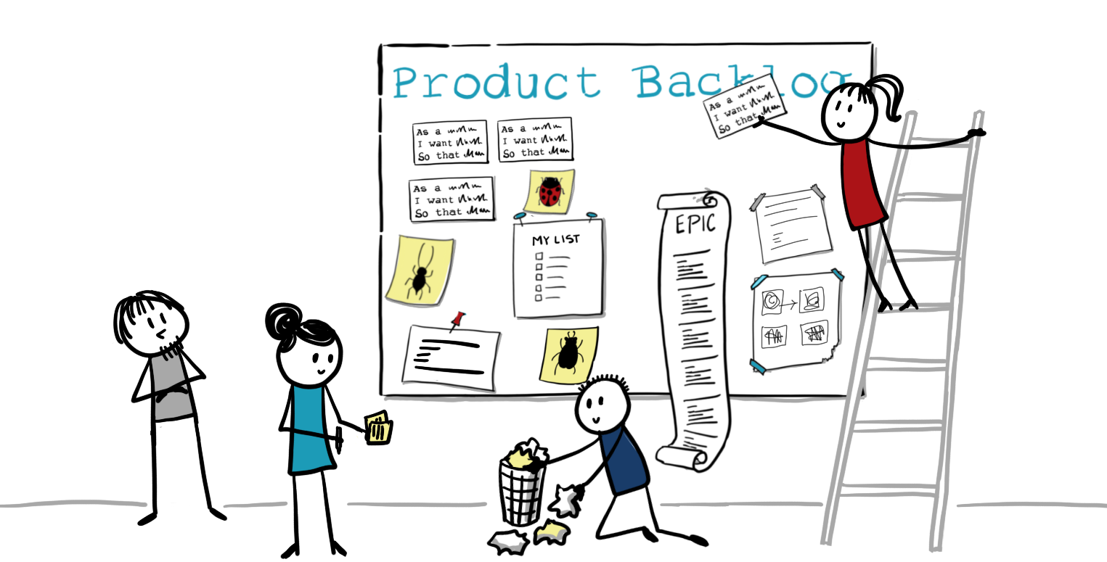
Product Owner in Scrum Events

Slide 10
Sprint Planning
2 Week Sprint
Sprint Planning - Part 1
Duration:
2 hours
Participants:
Product Owner, Scrum Master, and the DevTeam
SMEs may also join
Activities:
PO speaks about Sprint Goal
PO offers the story to the devTeam to be included in the current Sprint
PO answers the queries by devTeam
PO strives for maximizing the Business Value
Results:
Sprint Backlog
Sprint Planning - Part 2
Duration:
2 hours
Participants:
Scrum Master and the Team
Product Owner and SMEs may also join
3. Activities:
PO answers queries by devTeam
4. Results:
Committed User Stories for the Sprint
Sprint Backlog
Sprint Planning
Stand Up
Sprint Review
Retrospective
Notes:
Speaker Notes
Discuss mechanics/process parts of Scrum framework
Roles
Product owner
Scrum Master
DevTeam
Artifacts
Product Backlog
Sprint Backlog
Potentially Shippable Increment
Ceremonies
Sprint Planning
Daily Standup
Sprint Review
Retrospective
Do not discuss mindset part of Scrum Framework

Slide 11
Stand Up
2 Week Sprint
Stand Up
Duration:
15 minutes
Participants:
Product Owner, Scrum Master, and the DevTeam
Activities:
PO also speak about his day (details may not be in Sprint &/or Product Backlog)
Each team member shares updates on User Stories/tasks
What I did yesterday?
What I will do today?
What are my impediments?
Results:
Information sharing
Ask for help, if needed
Subsequent discussions/meetings, if needed
Sprint Planning
Stand Up
Sprint Review
Retrospective
Notes:
Speaker Notes
Day starts with Stand Up
It is not a status meeting but information sharing meeting
Impediments/blockers mention is essentially call for help
In case of impediment, one of the team member volunteer to help to remove it. If no one offers help then SM take it and facilitates the resolution.
PO is not a mute spectator. He should also share his work and challenges with team. His work may not be in Sprint and/or Product Backlog
DevTeam leads the meeting.
Meeting may follow one of the following pattern:
1. One member discuss all of his work and then next one takes over
2. Each member speaks about his part of a single story
SM facilitates the meeting but does not lead the meeting.
SM ensures that all of the team members get opportunity to speak and all team members attend the meeting
Stand Up may result in subsequent focused meeting/discussions involving fewer team members

Slide 12
Sprint Review
2 Week Sprint
Sprint Review
Duration:
2 hour at end of the Sprint
Participants:
Product Owner, Scrum Master, the DevTeam, and stakeholders
3. Activities:
PO leads the meeting
The team discusses the workings of the Sprint
The team collect feedback from stakeholders
4. Results:
Feedback is received
Product Backlog is updated
Input for future Sprint Planning meeting
Sprint Planning
Stand Up
Sprint Review
Retrospective
Notes:
Speaker Notes
One of the last meeting of a Sprint
Conducted at last day of the current Sprint
Goal: inspect the Increment and adapt the Product Backlog
Attendees collaborate on the next things that could be done to optimize value It is not a status meeting
The SM ensures that the event takes place and that attendants understand its purpose
The PO represents the team and devTeam demonstrates the increment
The PO decides what to demonstrate
The PO explains what Product Backlog items have been “Done” and what has not been “Done” and future plans
The DevTeam discusses what went well during the Sprint, what problems it ran into, and how those problems were solved
DevTeam does demonstration of increment
Team collects feedback from stakeholders
Participants may review of the timeline, budget, potential capabilities, and marketplace for the next anticipated release of the product.

Slide 13
Retrospective
2 Week Sprint
Retrospective
Duration:
Typically 1 to 1.5 hour
Participants:
Product Owner, Scrum Master, and the DevTeam
Activities:
Discussion on what went well, what went wrong, and what could be different
Looking into a mirror
Results:
Prioritized list of improvements
Sprint Planning
Stand Up
Sprint Review
Retrospective
Notes:
Speaker Notes
The last meeting of the current Sprint
It is a private meeting
Conducted at last day of the current Sprint
Goal: Inspect the self and lay the path of improvement
The Scrum Master ensures that the event takes place and that attendants understand its purpose.
The Scrum Master participates as a peer team member in the meeting from the accountability over the Scrum process.
The purpose of the Sprint Retrospective is to:
Inspect how the last Sprint went with regards to people, relationships, process, and tools;
Identify and order the major items that went well and potential improvements; and,
Create a plan for implementing improvements to the way the Scrum Team does its work.
By the end of the Sprint Retrospective, the Scrum Team should have identified improvements that it will implement in the next Sprint.
Although improvements may be implemented at any time, the Sprint Retrospective provides a formal opportunity to focus on inspection and adaptation.
Trust is very important in this meeting. Participants must be assured that what ever discussed in this meeting will not be used against them
Participants may decide to release selective findings of meeting.

Slide 14
Refinement
2 Week Sprint
Sprint Planning
Refinement
Duration:
1 to 2 hr. per week
Participants:
Product Owner, Scrum Master, the DevTeam, SMEs, and others
3. Activities:
PO leads the meeting
PO, SMEs, and others answers the queries raised by DevTeam
Refine the PBIs
Estimate PBIs (optional)
4. Results:
Refined PBIs
Updated Product Backlog
Stand Up
Sprint Review
Retrospective
Demonstration
Refinement
Notes:
Speaker Notes
It is not a meeting put a continuous process
Most of the teams conduct specific meeting to formalize Product Backlog refinement
Start with once in a week – 1 to 2 hr. Later on team may adjust as required

Slide 15
Demonstration
2 Week Sprint
Sprint Planning
Demonstration
Duration:
30 min to 1 hr
Participants:
Product Owner, Scrum Master, the DevTeam, and stakeholders
3. Activities:
PO leads the meeting
SM facilitates the meeting
The devTeam demonstrates increment to participants
The team collect feedback from stakeholders
4. Results:
Feedback is received
Product Backlog is updated
Stand Up
Sprint Review
Retrospective
Demonstration
Refinement
Notes:
Speaker Notes
This meeting is not in Scrum Guide
As per Scrum Guide, team demos increment during Sprint Review but few teams have separate demo because of slightly different motive and audiences.
Demo goal: To show off the increment to current & potential customers/users and sponsors
PO facilitates demo but DevTeam does it
PO may decides to demo selective part of increment
Team collects feedback from participants

Slide 16
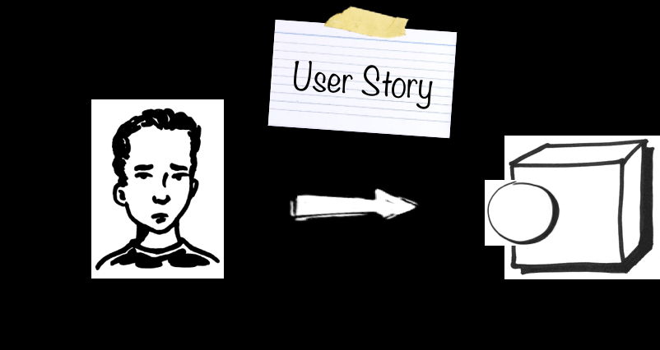

Tips for Successful User Story Writing

Slide 17
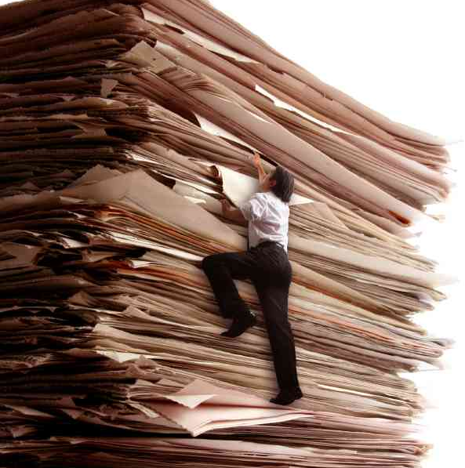
What is wrong with classic written Requirements?
Mandatory
Fixed
Hard to Change
Feature Centric rather than Value Centric
Specify the What, not the Why
Critical bits hidden in the detail
Expensive
Slow us down
Easy to verify, Hard to validate

Slide 18

Why User Stories
User Centric – what’s important to your customer
Story – the power of narrative, emphasizes verbal communication and defers details
Focus on the benefit, the value, what’s important
Supports ‘pull’ of information as its needed – Iterative development and planning

Slide 19

What happens when only one person writes the stories?
Lots of questions!
What should we do if the user’s account is expired?
Wouldn’t users prefer to do this story after having done that other story?
Why do users want to do this at all?
Can all users do this or just some?
How should we handle it when this rare thing happens?
Co-creation of user stories creates a shared understanding
Does that mean the whole team has to write the user stories all the time? No

Slide 20
How to build non-functional requirements into your user stories?
Make NFRs part of the user story
If not feasible, write a separate user story, for example it is system-wide
Use the “back” of a user story card to capture the performance and any other non-functional acceptance criteria
Retool the “definition of done” to include both front and back-of-card details
Leverage capabilities to gather automated performance results from the initial build, and automatically run these with deploys into the first environments
Performance accountability and ownership for a user story, factored in from the beginning
If research needs to be done in order to fulfil a prioritized story, then create a “spike” story for the current sprint and take the story into the next sprint

Slide 21
“Technical Stories” and Scrum
There is a What-World and a How-World.
A User Story is for Users, generating Business Value aka Secondary Value in the What-World. Scrum is mostly What-World only. It says little to nothing about the How-World, basically no more than "How-World is the responsibility of the Dev-Team"
User Story vs Task
Usually, Backlog Items which are for the How-World are not called User Story but Technical Task or Subtask
Many tools allow breaking down the User Story from the What-World into Subtasks in the How-World.

Slide 22

Not enough detail in the Story
Starting sprint without enough information leaves teams:
Needing to ask lots of questions during the sprint
PO needing to get back to the team with lots of answers
Waiting for PO responses
Sometimes the answers make the story bigger and/or more complex than originally thought
Unprepared for the following sprint
This leads to unfinished committed stories and lowers velocity

Slide 23

Not enough detail in the Story
Starting sprints with too much information
Highly detailed acceptance criteria
Prototypes of screens already created
Stories created too soon that become stale and need rework
This also leads to unfinished committed stories and lowers velocity

Slide 24

How much detail do we need?
How much is enough?
Enough detail so that they could barely finish the story in one sprint
If they could not have finished it if they had needed to get one more detail
Not so detailed that all creativity is removed and the team feel like “code monkeys”!
Just enough detail to complete this sprint’s user stories just in time

Slide 25

How do you figure that out?
There’s no arbitrary answer to how much detail is necessary, every team is different, every product is different
Ask the teams in their retrospectives –
“Did you have just enough detail to complete this Sprint’s user stories and was that information provided just in time?”
They need to ask themselves if they could have gotten by on more/less detail
Gradually, you will all begin to see a pattern in the stories, and which ones are most effective – and how much detail they had
If this happens the teams should come to understand what level of detail is needed over time

Slide 26
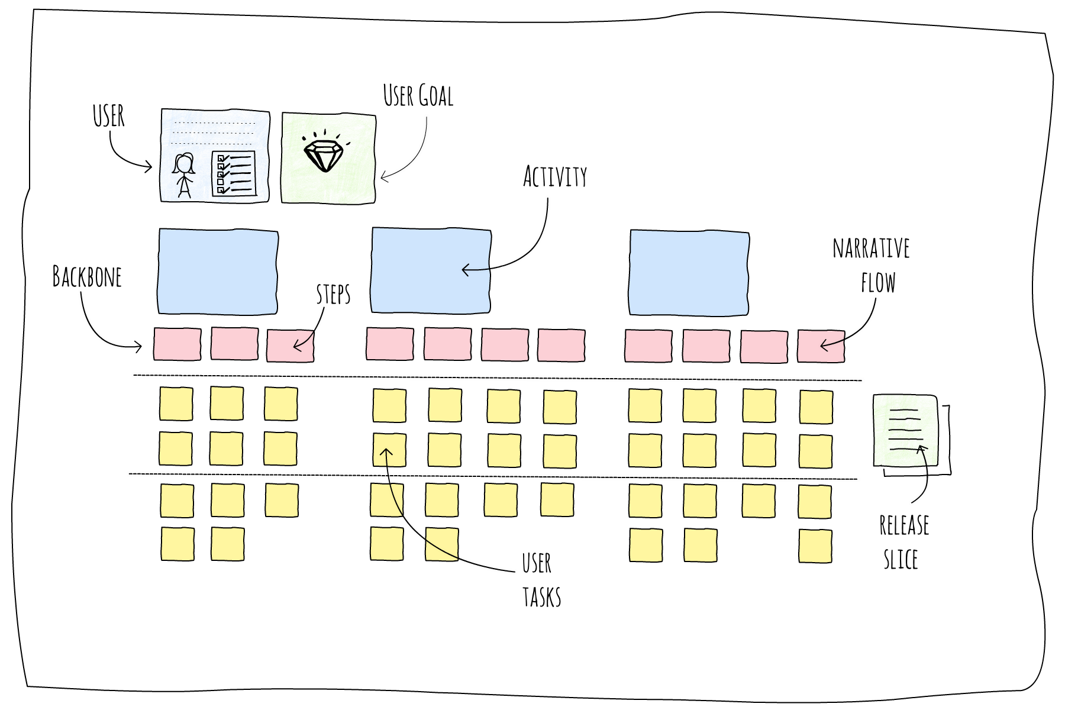
Story Map

Slide 27
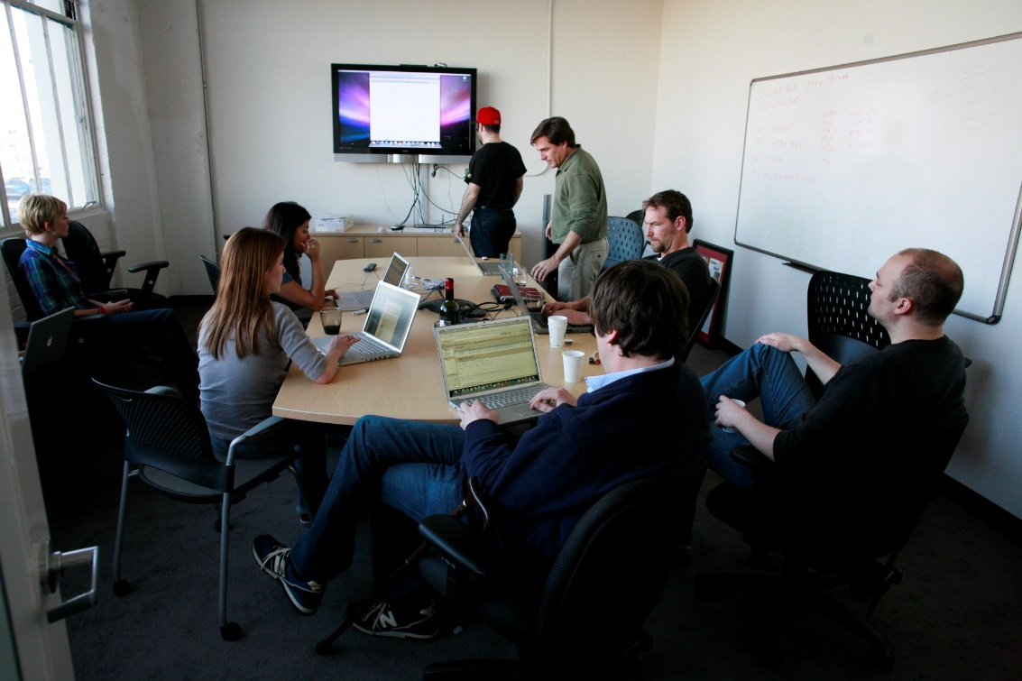
Tips for a successful Story-Writing Workshop
Focus the meeting on a single significant objective (something which takes at least three months to produce)
Minimum Viable Product (MVP)
Useful at the beginning of product development
Minimum Marketable Feature (MMF)
Significant objective
Have the right participants
Product Owner
Development Teams
Scrum Master/Coach
Technical Product Owner
Visualize the relationships between Stories

Slide 28

Visualization of the Stories
Story Mapping is one way of visualizing the requirements, in the form of user stories
A user story represents a small piece of business value that a team can deliver in an iteration.
Business, and other, users of the system seldom conceptualize stories at such a granular level without guidance from the Team
The output of user story mapping is a product roadmap that clearly conveys the context of each user story, the horizontal slices of the MVP, and the aspirational scope of the product.

Slide 29
Story Mapping
2-dimensional view of what the system needs to do
Helps you find steps (i.e. stories) you may have overlooked:
What will the user most likely want to do next?
What mistakes could a user make here?
What could confuse the user at this point?
What additional information could a user need?
Horizontally sequence
Document everything you need to do in order to complete a feature
Insert then between each of the steps
Alternatives are documented vertically
Insert between each of the alternatives a horizontal line, representing a release

Slide 30
Story Mapping
Story mapping consists of ordering user stories along two independent dimensions. The "map" arranges user activities along the horizontal axis in rough order of priority (or "the order in which you would describe activities to explain the behaviour of the system"). Down the vertical axis, it represents increasing sophistication of the implementation
Given a story map so arranged, the first horizontal row represents a "walking skeleton", a barebones but usable version of the product. Working through successive rows fleshes out the product with additional functionality
From the Agile Alliance - http://.agilealliance.org

Slide 31
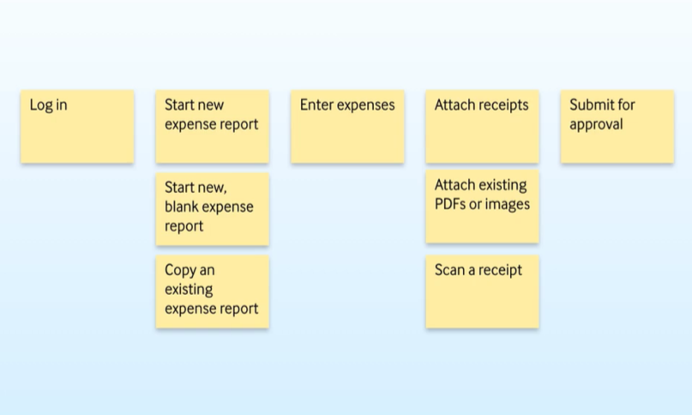
Example Story Map

Slide 32
Release Planning
You can use the story map in order to do release management too
First you will need to estimate each user story on the map
Ensure that you know your velocity, you will need this for planning
Decide how many stories you believe you need to complete for the first release and draw an horizontal line underneath those stories (you may need to provide)
Next, look at all of the rows of alternatives, and decide which ones you believe will be needed in the next releases, you can label that row “Needed soon”, beneath that you will draw another line, which can be labelled “Nice to have”
You would then work through the stories in prioritized order, which may change with business needs

Slide 33
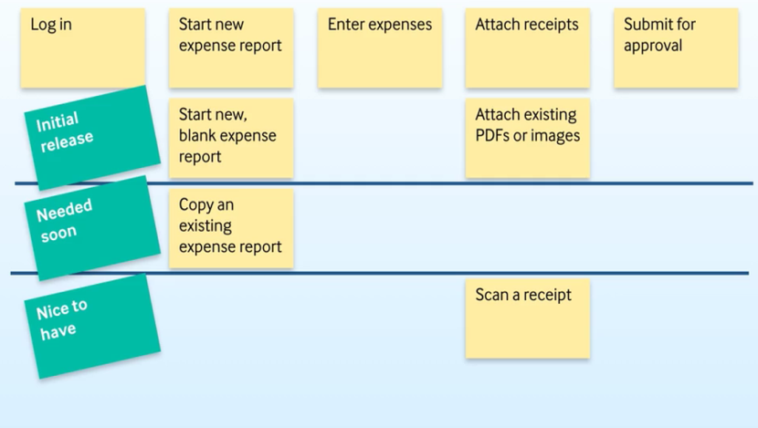
Example Release Planning

Slide 34
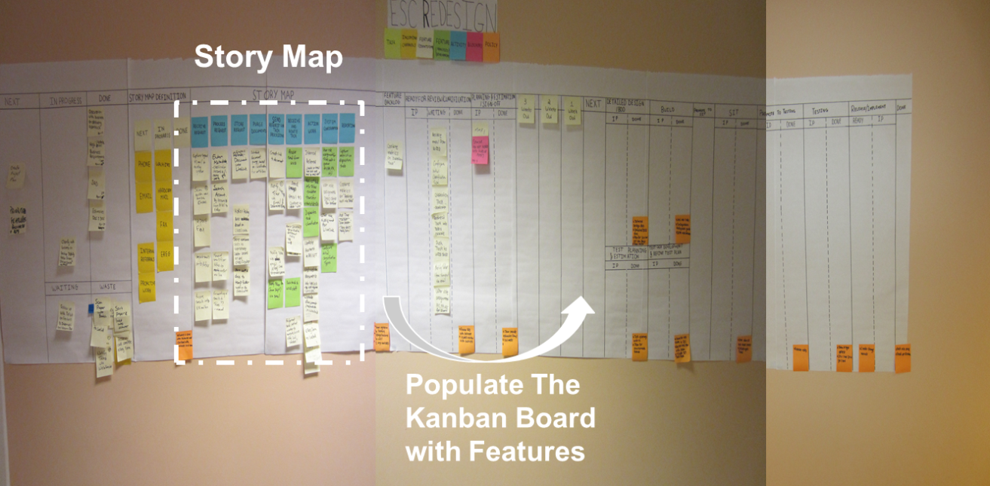
Story Map to Kanban/Scrum Board

Slide 35
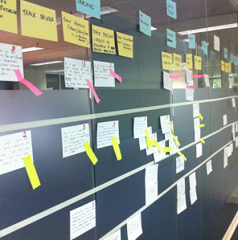
Story Mapping: Summary
Frame the Effort
Before mapping, create a short product or feature brief to frame and constrain what you map.
Think of this as the big story. Focus on getting the whole story
Think “milewide, inch deep”
The activities and high-level user tasks that tell the whole story form the backbone of your story map
Map the Big Picture I
Imagine a typical day in your user’s life with your new product
Map the steps they take as user tasks left to right
Fill the body of your story map by breaking down larger user tasks into smaller subtasks and user interface details

Slide 36
Story Mapping: Summary
Explore
Start with the user type most critical to your product’s success
During this phase you’ll add cards, split one card into two, rewrite cards, and reorganize them. Use this phase to think “blue sky”
Slice Out Viable Releases
Slice your map into holistic product releases that span the users and use of the product
These slices form an incremental product release roadmap where each release is a minimal viable product release
Slice the first release of your map into three or more delivery phases that allow you and your team to learn fast and avoid risk
Slice Out a Development Strategy
Think about all the great possibilities.. Think of the opening, mid, and end-game phases of a chess game
This development strategy will help you release the best product possible in the time constraints you have

Slide 37
Exercise - Story Mapping & Release Planning
Procedure
As a group, create a story map with of the stories from your project
Discuss and decide which stories are the primary stories that describe the steps in the processes created
Supplement each of these with the smaller stories that comprise the main stories and put them on the story map
Give each story a rough sizing of 1, 3,5, 8, or 13
Decide your team’s approximate velocity (how many points they can fit into a sprint), and group the stories for the first, second and third release
Group review of Story Map

Slide 38
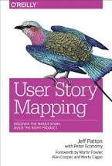
Books Recommendations

Slide 39
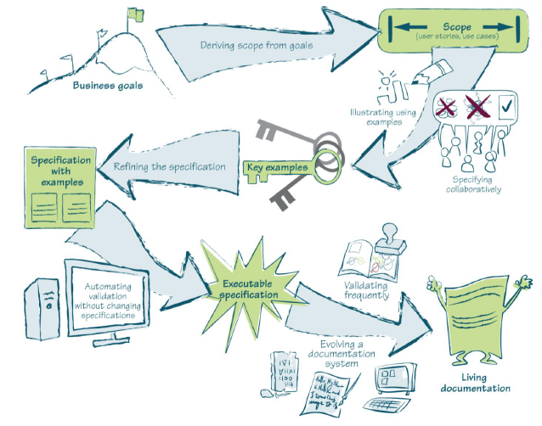
Specification by Example

Slide 40
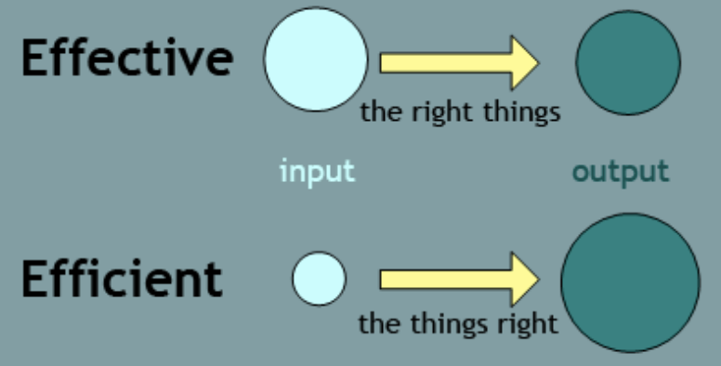
Effectiveness
To build the right product effectively, software development practices have to provide the following:
Assurance that all stakeholders and delivery team members understand what needs to be delivered in the same way
Precise specifications so delivery teams avoid wasteful rework caused by ambiguities and functional gaps
An objective means to measure when a piece of work is complete
Documentation to facilitate change, in terms of both software features and team structure

Slide 41
Specification by Example
building the product right and building the right product are two different things. We need to do both in order to succeed.
Built Right
Business failure
Success
Community focus in
last 10 years
Specification by example
Right Product
Useless Crap
Maintenance
nightmare
Specification by Example helps teams build the right software product,
Complementing the technical practices that ensure that the product is built right
How Successful Teams Deliver the Right Software [Gojko Adzic] - 2011

Slide 42
Agile Documentation
We need a solution that gives us a way to:
Avoid wasteful over-specifying; avoid spending time on details that will change before a piece of work is developed
Have reliable documentation that explains what the system does so we can change it easily
Efficiently check that a system does what the specifications say
Keep documentation relevant and reliable with minimal maintenance costs
Fit all this into short iterations and flow-based processes, so that the information on upcoming work is produced just-in-time

Slide 43
Key factors
Agile Documentation
Precise and
objectively testable
Easy to
Maintain
Flow-based Processes
Written Just-in-time

Slide 44
Process Patterns
Business Goals
Scope
(User Stories)
Specification with Examples
Executable Specification
Living Documents
Key Examples
Deriving scope from goals
Validating frequently
Evolving a documentation system
Specifying Collaboratively
Illustrating Using Examples
Automating validation without changing the specifications
Refining the specification

Slide 45
Deriving Scope from Goals
Implementation scope offers a solution to a business problem
If business people define the scope we are asking them to define the solution
This results in software that does what the business asks for – not what they really wanted or needed
Instead of accepting requirements as a solution to an unknown problem successful teams derive scope from goals
Begin with the business goal
The PO should concentrate on the intent and value of that goal
The team (which could include other areas of technology, such as production support, architecture and operations), then suggests a solution that’s cheaper, faster, and easier to deliver and maintain than what the business could come up with on their own

Slide 46

Example of a Business Goal
A business goal should be measurable
A measurable goal makes it possible to:
Tell if an effort succeeded
Track progress
Prioritize better
An example of a business goal might be: “Increase repeat sales to existing customers by 50% over the next 12 months”
This goal is probably very different than this one:
“Increase repeat sales to existing customers by 500% over the next 3 months”

Slide 47
Scope
As a/an user type I want feature so I benefit
Example user stories for a backend system:
As a bank, I want to receive a file showing all checks to be cleared so that I can debit and credit the right accounts.
As a bank, I want to receive a correctly formatted 5300 file so that I can adjust balances as appropriate.
As a bank, I want to receive a file showing the status of all resubmitted transactions so that I can update the database with new information.
Example user stories for a front-end system:
As a banking customer, I want an email sent to me when my account goes into overdraft, so that I can remedy the situation
As a bank teller, I would like to have a currency converter, so that I can tell my customer what the exchange rate would be

Slide 48

Key Examples
Key examples must be concise to be useful
Remove extraneous information and create a concrete and precise context for development and testing
Identify what the software is supposed to do, not how to do it
Refined examples can be used as acceptance criteria for delivery
Development isn’t done until the system works correctly for all examples
Teams create specifications with examples which are:
A specification of work
An acceptance test
A future functional regression test

Slide 49
Acceptance Criteria/Specification
User story: As a banking customer, I want an email sent to me when my account goes into overdraft, so that I know that I need to put money in my account
Acceptance criteria/
example:
Input | Process | Output
Valid email address | Email validation | Message sent to email address
Invalid email address | Email validation | Flag online profile as incomplete, kickoff letter by mail
Valid email address | Marketing messaging | Marketing message copy matches copy provided by Marketing
Valid email address | Marketing messaging | Marketing message design matches the specs provided by marketing
Valid email address | Marketing messaging | Message contains web link that allows the user to navigate to online banking
Valid email address | Email validation | Message sent to email address

Slide 50

Automating Validation
Without changing specifications
Refined specifications with examples can be used as a target for implementation and a means to validate the code
The system will be validated multiple times using these tests – doing them manually creates delays
They should be easily understood by all team members, including the PO
When the requirements change or when developers need more clarification the automated tests must be the same as the specification
It also automatically becomes living documentation and only needs to be updated in one place
It is an executable specification

Slide 51
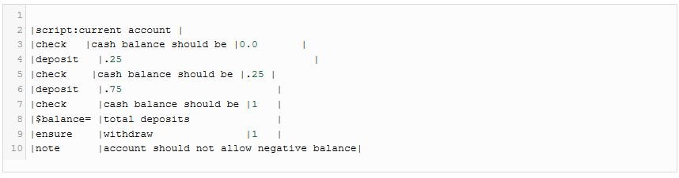
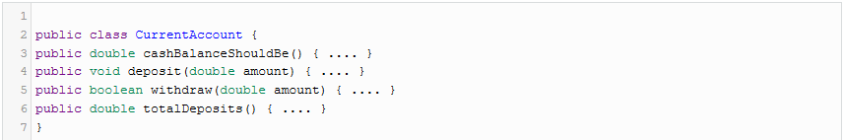
Script Table Example
Script tables are one of the most flexible table styles and can be used for scenario or story based testing.
Java code

Slide 52
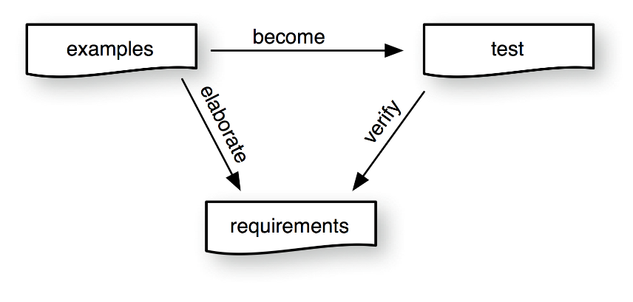
The Relationships

Slide 53
Summary of Benefits
Implementing changes more efficiently
Living documentation
A reliable source of information on system functionality
It enables you to analyze the impact of potential changes and share knowledge effectively
Higher product quality
Clearly defined expectations and a validation process which is efficient
Less rework
Better specifications
A shared understanding of expectations by all team members
Better alignment of the activities of different roles on a project
Improved collaboration leads to a more regular flow of delivery

Slide 54
To Sum up …
The key process patterns of Specification by Example are:
deriving scope from goals
specifying collaboratively
illustrating specifications using examples
refining the specifications
automating validation without changing the specifications
validating the system frequently, and evolving living documentation
With Specification by Example, functional requirements, specifications, and acceptance tests are the same thing
The result is a living documentation system that explains what the system does and that is as relevant and reliable as the programming language code but much easier to understand
Teams in different contexts use different practices to implement process patterns

Slide 55









Tools

Slide 56

Books Recommendations

Slide 57

Persona

Slide 58
A Research
Research in car drivers shows that on average a car driver has 1.9 lags (many has 2, some has 1)
Will you design a car for drivers having 1.9 lags?

Slide 59
You need Persona if …
Product Backlog is a long list of faceless features;
Features are prioritized based on – “who shouts out loudest”
Product has no real user feedback
The term “user” means different things to different stakeholders

Slide 60
Persona
Persona is a archetype that describes in a realistic fashion key attributes, behaviors, and attitudes of user base

Slide 61
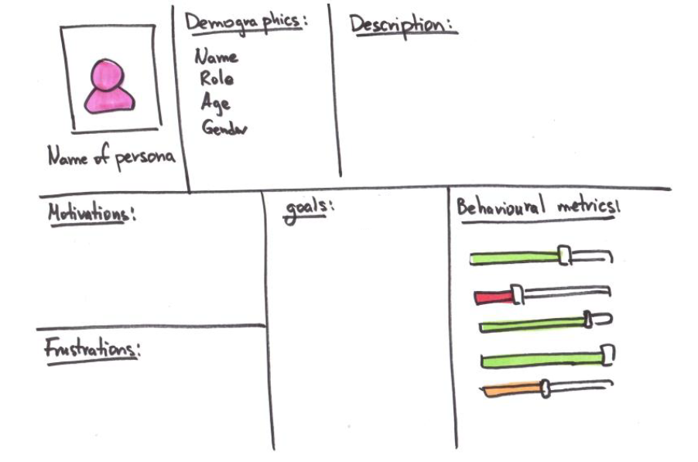
Persona template

Slide 62
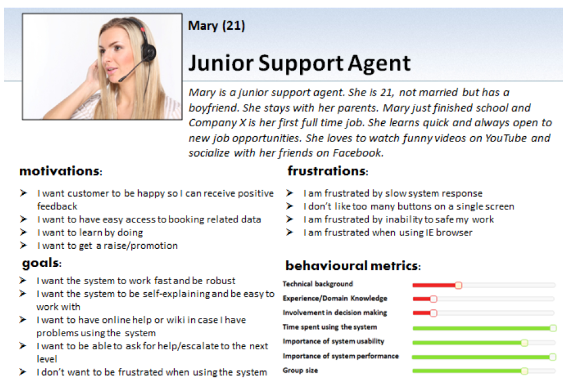
Persona example

Slide 63

Common Persona mistakes
The generic Persona
Traits common to most of the users
Trying to be everything for everyone
Personas that separate
Real user ignored in favor of Persona
The representative Persona
Not an accurate representation of users
Insufficient market and demographic research performed
Extreme Persona
Persona laying on the edge of your user base

Slide 64
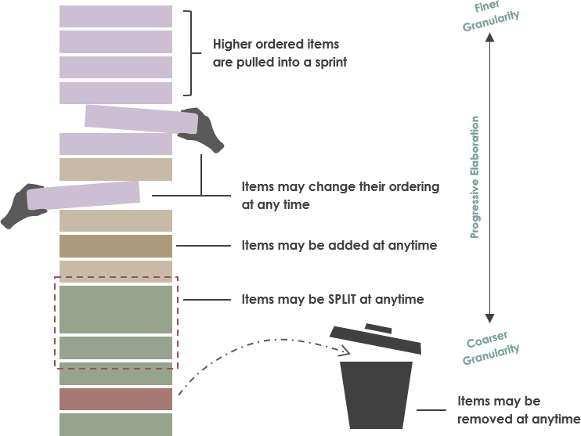
Product Backlog Prioritization

Slide 65
Product Backlog
A Product Backlog is simply a prioritized list of all work items, classified as
Epics/ Features / User Stories - Prioritized list of project requirements and enhancements with estimates (of high priority items) to turn them into completed product functionality
Technical debts - Items like engineering improvement goals and exploratory / research with appropriate estimate.
Defects – Known defects with appropriate estimate
Fine-grained Backlog Items ready for next Iterations/ Sprints i.e. smaller user stories
High priority
Medium-grained Backlog Items for current Release
Product Backlog
Coarse-grained Backlog items for Future Releases
Low priority

Slide 66
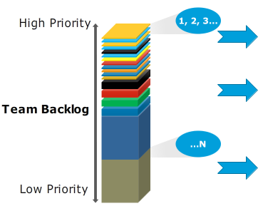
Prioritizing User Stories
The stories to prioritize at the top of the product backlog are the ones that will deliver the greatest business value,
The highest priority user stories should be done first.
The Product Owner or product team must spend time early in the product lifecycle to define the business value criteria.
The business value of a user story could be expressed in different ways.
The product owner may choose to focus on value e.g. to get more users, revenue (to increase the cash flow), validated learning (to better prepare the future), stability (to boost customer retention) etc.
Prioritized Product Backlog
Fine-grained Backlog Items ready for next sprints i.e. smaller user stories
Medium-grained Backlog Items for current Release
Coarse-grained Backlog items for Future Releases
Notes:
https://dzone.com/articles/6-backlog-prioritization

Slide 67
Prioritizing User Stories: MoSCoW Technique
MoSCoW is a fairly simple way to sort features (or user stories) into priority order - a way to help teams quickly understand the customer's view of what is essential for launch and what is not. MoSCoW stands for:
Must have (or Minimum Usable Subset) Should have Could have Won't have (but Would like in future) Must Haves are features that must be included before the product can be launched. This is the minimum scope for the product to be useful and meet customer needs. Should Haves are features that are not critical to launch, but are considered to be important and of a high value to the user. Could Haves are features that are nice to have and could potentially be included without incurring too much effort or cost. These will be the first features to be removed from scope if the project's timeline or budgets are at risk. Won't Haves are features that have been requested but are explicitly excluded from scope for the planned duration, and may be included in a future phase of development.
Notes:
https://dzone.com/articles/6-backlog-prioritization

Slide 68
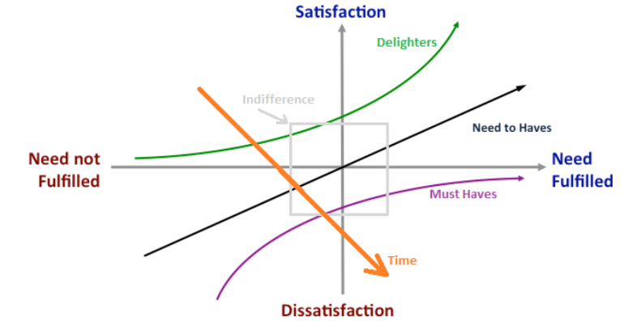
Prioritizing User Stories: Kano Model
Must Haves
These are the requirements that the customers expect and are taken for granted. When done well, customers are just neutral, but when done poorly, customers are very dissatisfied. Kano originally called these “Must-be’s” because they are the requirements that must be included and are the price of entry into a market.
Need to Haves
These attributes result in satisfaction when fulfilled and dissatisfaction when not fulfilled. These are attributes that are spoken and the ones in which companies compete.
Delighters
These attributes provide satisfaction when achieved fully, but do not cause dissatisfaction when not fulfilled. These are attributes that are not normally expected. Since these types of attributes of quality unexpectedly delight customers, they are often unspoken.
Indifference
These attributes refer to aspects that are neither good nor bad, and they do not result in either customer satisfaction or customer dissatisfaction.
With time and competitive pressure, Delighters turns into Must Haves.
Ref: https://github.com/tusjain/agileanswer/blob/master/repository/Kano%20Model.pdf
Notes:
https://dzone.com/articles/6-backlog-prioritization

Slide 69
Prioritizing Epics, Features or Stories: WSJF
Weighted Shortest Job First (WSJF) is a prioritization model used to sequence “jobs” (e.g., Epic and Features) to produce maximum economic benefit.
We need to establish both the cost of delay and the duration for each job. There are three primary elements that contribute to the cost of delay:
User-Business Value: Do our users prefer this over that? What is the revenue impact on our business? Is there a potential penalty or other negative impact if we delay?
Time Criticality: How does the user/business value decay over time? Is there a fixed deadline? Will they wait for us or move to another solution? Are there milestones in the critical path impacted by this?
Risk Reduction-Opportunity Enablement Value: What else does this do for our business? Does it reduce the risk of this or a future delivery? Is there value in the information we will receive? Will this feature open up new business opportunities?
Since we are in continuous flow and should have a large enough backlog to choose from, we needn’t worry about the absolute numbers. We can just compare backlog items relative to each other. Duration can be swapped with Job Size.
Cost of Delay = User-Business Value + Time Criticality + Risk Reduction and/or Oppty Enablement
WSJF = Cost of Delay / Job Size
Notes:
http://www.scaledagileframework.com/wsjf/

Slide 70
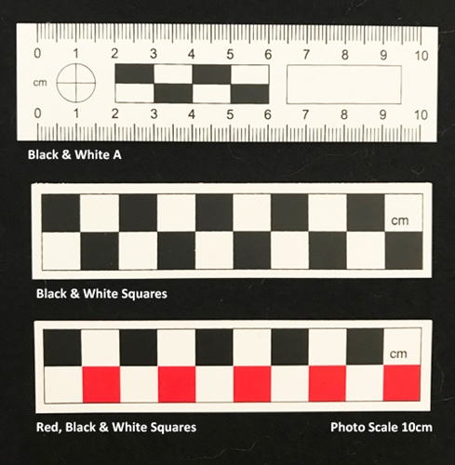
Reference Scale
Ref: https://agileanswer.blogspot.com/2018/09/relative-estimation-epics-features-and.html

Slide 71
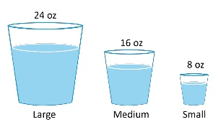
Absolute vs. Relative Estimate
Absolute Estimate: Each item is estimated in isolation without comparing it with other items
Relative Estimate: Items are compared and ordered or assigned an arbitrary number/designation to depict order

Slide 72
Estimating an Story
A story point is a singular number that represents a combination of qualities:
Volume – How much is there?
Complexity – How hard is it?
Knowledge – What’s known?
Uncertainty – What’s unknown?
Story points are relative, without a connection to any specific unit of measure. The size (effort) of each story is estimated relative to the smallest story, which is assigned a size of ‘one.’ A Fibonacci sequence (1, 2, 3, 5, 8, 13, 21, …) is applied that reflects the inherent uncertainty in estimating.
Stories are estimated by DevTeam

Slide 73
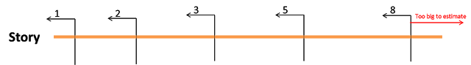
Estimating an Story
Use a starting baseline where one story point is defined roughly the same across all teams. This means that work can be prioritized based on converting story points hours. Normalized story points provide a method for getting to an agreed starting baseline for stories:
Give every DevTeam member eight points (adjust for part-timers).
Subtract one point for every team member vacation day and holiday.
Find a small story that would take one day to complete (dev, test, and validate). Assign one Story Point to this Story.
Estimate every other story relative to that ‘one.’
Exercise 1: Pick a story from your work area of size one Story Point and the estimate the size of two other stories.
Exercise 2: Play Planning Poker

Slide 74
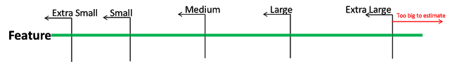
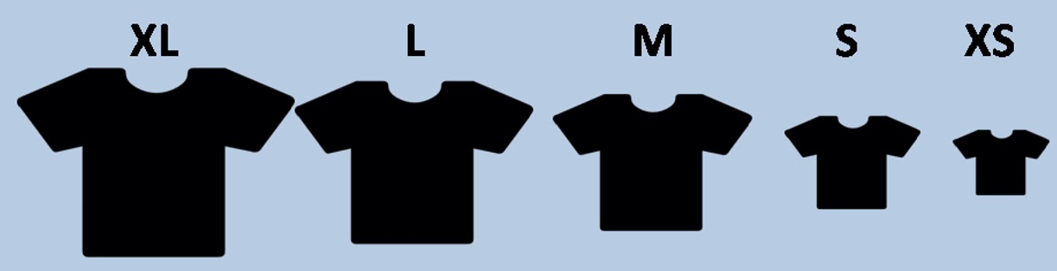
Estimating a Feature
A Feature is estimated using T-shirt sizing
Extra Small (XS)
Small (S)
Medium (M)
Large (L)
Extra Large (XL)
Features are estimated by Product Owner, Tech Architects, Product Manager with inputs of DevTeam

Slide 75
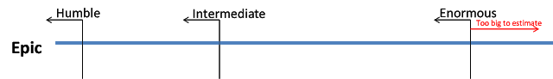

Estimating an Epic
To estimate an Epic use ordering protocol method (arranging big to small in an ordered list)
Enormous
Intermediate
Humble
Epics are estimated by Executives with inputs of Product Owner, Tech Architects, and Product Manager

Slide 76
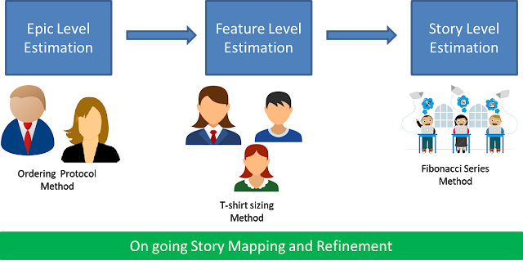

Slide 77
Next Step
Over the time, the organization builds a reference map to have a range based correlation of all three levels of requirements.
To build these reference maps representative epics, features, and stories are contributed to reference scale by Epic owners, PMs/POs, and DevTeams. To keep the reference scale up to date:
Epics older than 6 months (or may be one year);
Features older than 3 months (or may be 6 months); and
Stories older than couple of Sprints should be dropped out from the reference scale.

Slide 78
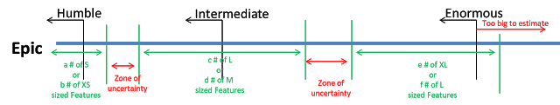
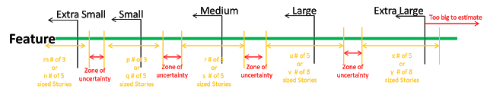
Next Step
Range based maps may look something like:
Purposefully, different scales are used for each level in requirement hierarchy.
In this estimation process, the emphasis is on estimation not on team capacity and cost of realization of a specific Epic/Feature/Epic.

Slide 79
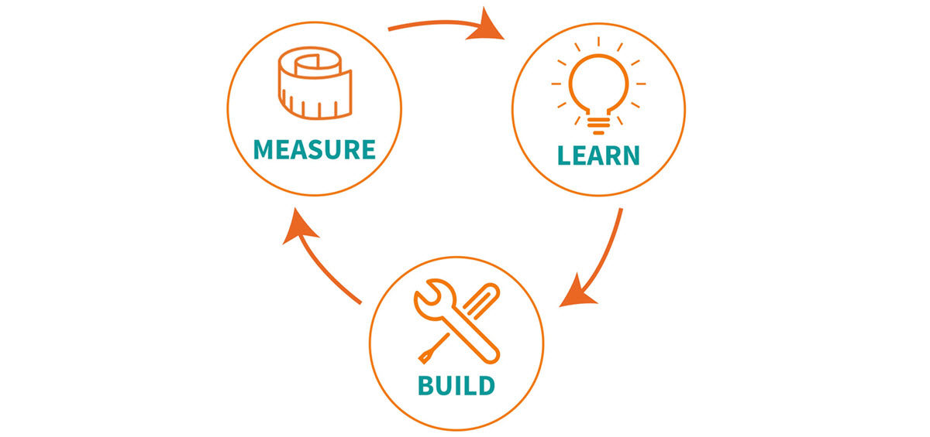
Minimum Viable Product (MVP)
Ref: https://github.com/tusjain/agileanswer/blob/master/repository/Minimum%20Viable%20Product.pdf
https://agileanswer.blogspot.com/2018/09/minimum-viable-product-and-minimum.html

Slide 80
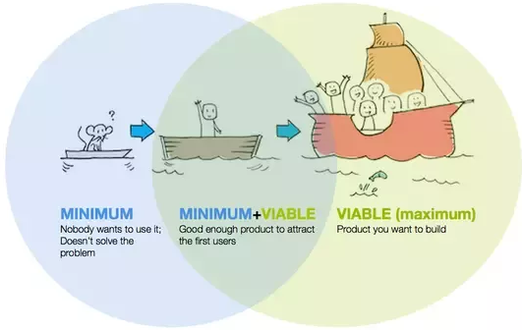
Minimal Viable Product
A Minimum Viable Product is that version of a new product which allows collecting the maximum amount of validated learning about customers with the least effort in least time frame.
Notes:
Facilitator leads retro of training, one category at a time with action items at the end.
Create a safe and courageous space to tell the truth and grow.

Slide 81
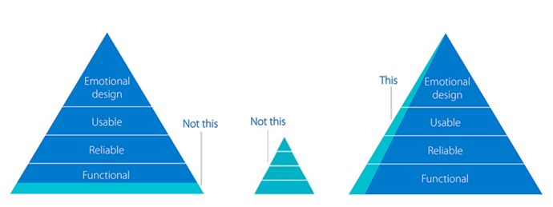
Minimal Viable Product
The big challenge is scope of MVP – What go include and what not to exclude. To decide scope of MVP, one simple thumb rule is – Is my customer will buy it and give the feedback?
MVP has three critical characteristics:
Valuable - people choose to use it or buy it;
Usable - people can figure out how to use it;
Feasible - team can deliver it when needed with the available resources
Notes:
Facilitator leads retro of training, one category at a time with action items at the end.
Create a safe and courageous space to tell the truth and grow.

Slide 82
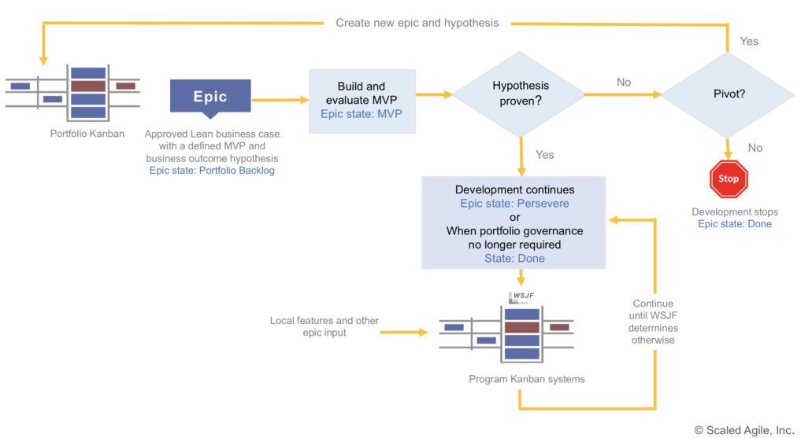
Lean Startup Cycle & MVP
Notes:
Facilitator leads retro of training, one category at a time with action items at the end.
Create a safe and courageous space to tell the truth and grow.

Slide 83
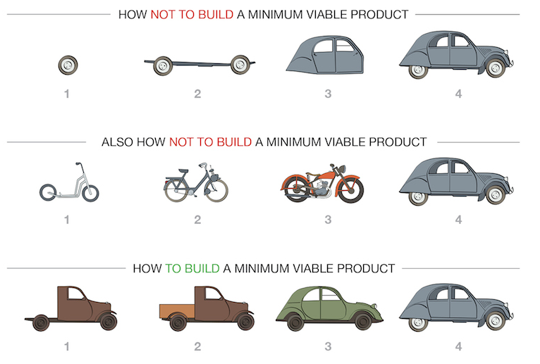
Lean Startup Cycle & MVP
Notes:
Facilitator leads retro of training, one category at a time with action items at the end.
Create a safe and courageous space to tell the truth and grow.

Slide 84

Books Recommendations

Slide 85
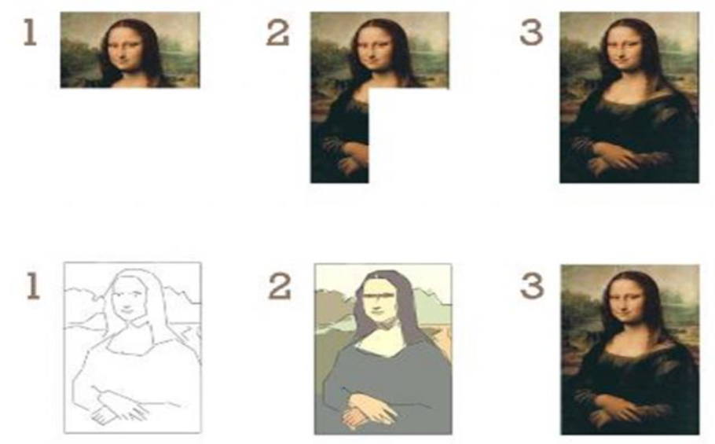
Which way do you like to develop your system?
Ref: https://github.com/tusjain/agileanswer/blob/master/repository/Incremental%20vs%20Iterative.pdf

Slide 86
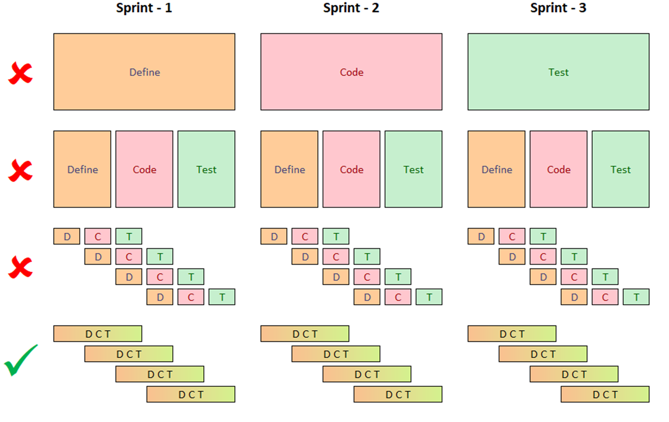
Agile way of Working
Ref: https://github.com/tusjain/agileanswer/blob/master/repository/Agile%20Way%20of%20working.pdf

Slide 87
Business Value
In Product Management, business value is an informal term that includes all forms of value that determine the health and well-being of the product and firm in the long run. Business value expands concept of value of the firm beyond economic value (also known as economic profit, economic value added, and shareholder value) to include other forms of value such as employee value, customer value, supplier value, channel partner value, alliance partner value, managerial value, and societal value. Many of these forms of value are not directly measured in monetary terms.
Business value often embraces intangible assets not necessarily attributable to any stakeholder group. Examples include intellectual capital and a firm's business model. The balanced scorecard methodology is one of the most popular methods for measuring and managing business value.
Notes:
For our purpose (internal product), we can break Business Value in four components:
Commercial Value: The most obvious one and consists of functionality or work that translates into profit directly; like:
Changes that reduce operating costs, like reduction in required servers by improving code;
Being able to send a bill to a customer for the work that was done;
Improve the subjective value of the application so people are willing to pay more for it (in Lean Six Sigma this is considered quality or customer value, something Apple is quite good at); etc.
The key question to ask is ‘How much revenue or profit does this work result in?’.
Market Value: It increases the potential number of customers, like:
Functionality that draws in a new group of customers;
Porting applications to other platforms, like smartphones, from iOS to Android, etc.
The key question to ask is ‘How many new customers will we be able to serve?’.
Efficiency Value: It increases organizational efficiency and thereby decreases operating costs, like:
Reduce the amount of errors in a task or increase speed (by automating it or parts of it)
Increasing the usability or quality of an application to reduce load on support desks;
Reducing the amount of time needed to set up new customer environments or deploy them;
Decreasing the time to market; etc.
The key question to ask is ‘How much time or money will this save us?’.
Customer Value: It increases the likelihood that customers will continue to use your product (‘make it stick better’), like:
Improving usability in an application to make it easier to use (and reduce frustration);
Adding a new feature that is commonly requested by users; etc.
The key question to ask here is ‘to what extent will this decrease the likelihood that a customer leaves?’.
Future Value: It increases the chances of more easily achieving one of the above values in the (near) future by investing in innovation and learning now, like:
Investing in a new (custom or open source) framework that can be used for future development;
Reducing technical debt in code to make future changes in the code easier or less error-prone; etc.
The key question to ask here is ‘How much will this save us in time or money in the future?’.

Slide 88
Business Value
For our purpose (internal product), we can break Business Value in four components:
Commercial Value: The most obvious one and consists of functionality or work that translates into profit directly; like changes that reduce operating costs, like reduction in required servers by improving code, etc.
The key question to ask is ‘How much revenue or profit does this work result in?’.
Market Value: It increases the potential number of customers, like functionality that draws in a new group of customers, etc.
The key question to ask is ‘How many new customers will we be able to serve?’.
Efficiency Value: It increases organizational efficiency and thereby decreases operating costs, like reduce the amount of errors in a task or increase speed (by automating it or parts of it), etc.
The key question to ask is ‘How much time or money will this save us?’.
Customer Value: It increases the likelihood that customers will continue to use your product (‘make it stick better’), like Improving usability in an application to make it easier to use (and reduce frustration), etc.
The key question to ask here is ‘to what extent will this decrease the likelihood that a customer leaves?’.
Future Value: It increases the chances of more easily achieving one of the above values in the (near) future by investing in innovation and learning now, like reducing technical debt in code to make future changes in the code easier or less error-prone, etc.
The key question to ask here is ‘How much will this save us in time or money in the future?’.
Notes:
For our purpose (internal product), we can break Business Value in four components:
Commercial Value: The most obvious one and consists of functionality or work that translates into profit directly; like:
Changes that reduce operating costs, like reduction in required servers by improving code;
Being able to send a bill to a customer for the work that was done;
Improve the subjective value of the application so people are willing to pay more for it (in Lean Six Sigma this is considered quality or customer value, something Apple is quite good at); etc.
The key question to ask is ‘How much revenue or profit does this work result in?’.
Market Value: It increases the potential number of customers, like:
Functionality that draws in a new group of customers;
Porting applications to other platforms, like smartphones, from iOS to Android, etc.
The key question to ask is ‘How many new customers will we be able to serve?’.
Efficiency Value: It increases organizational efficiency and thereby decreases operating costs, like:
Reduce the amount of errors in a task or increase speed (by automating it or parts of it)
Increasing the usability or quality of an application to reduce load on support desks;
Reducing the amount of time needed to set up new customer environments or deploy them;
Decreasing the time to market; etc.
The key question to ask is ‘How much time or money will this save us?’.
Customer Value: It increases the likelihood that customers will continue to use your product (‘make it stick better’), like:
Improving usability in an application to make it easier to use (and reduce frustration);
Adding a new feature that is commonly requested by users; etc.
The key question to ask here is ‘to what extent will this decrease the likelihood that a customer leaves?’.
Future Value: It increases the chances of more easily achieving one of the above values in the (near) future by investing in innovation and learning now, like:
Investing in a new (custom or open source) framework that can be used for future development;
Reducing technical debt in code to make future changes in the code easier or less error-prone; etc.
The key question to ask here is ‘How much will this save us in time or money in the future?’.

Slide 89
Session Retrospective
Notes:
Stop Start Continue

Slide 90
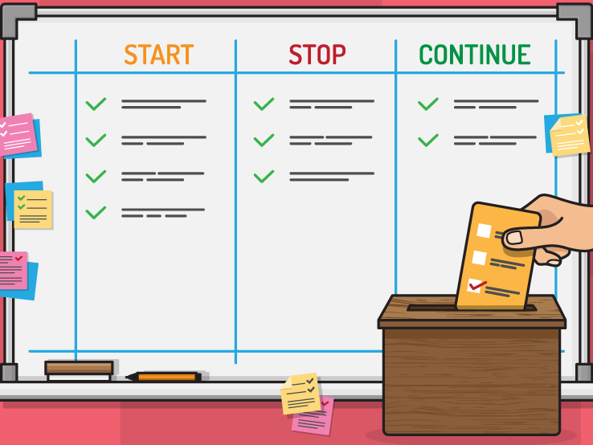
Session Retrospective
Notes:
Facilitator leads retro of training, one category at a time with action items at the end.
Create a safe and courageous space to tell the truth and grow.

Slide 91
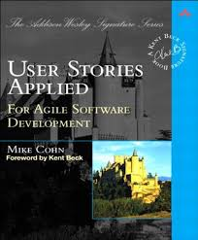
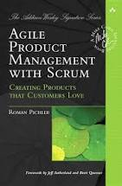
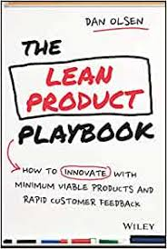
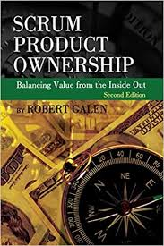
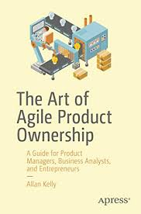
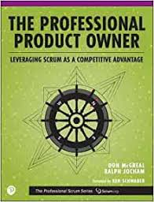

Books Recommendations

